Slide 1

API Gateway
Programming example
API Gateway + lambda
Other ways to call lambda functions

Slide 2
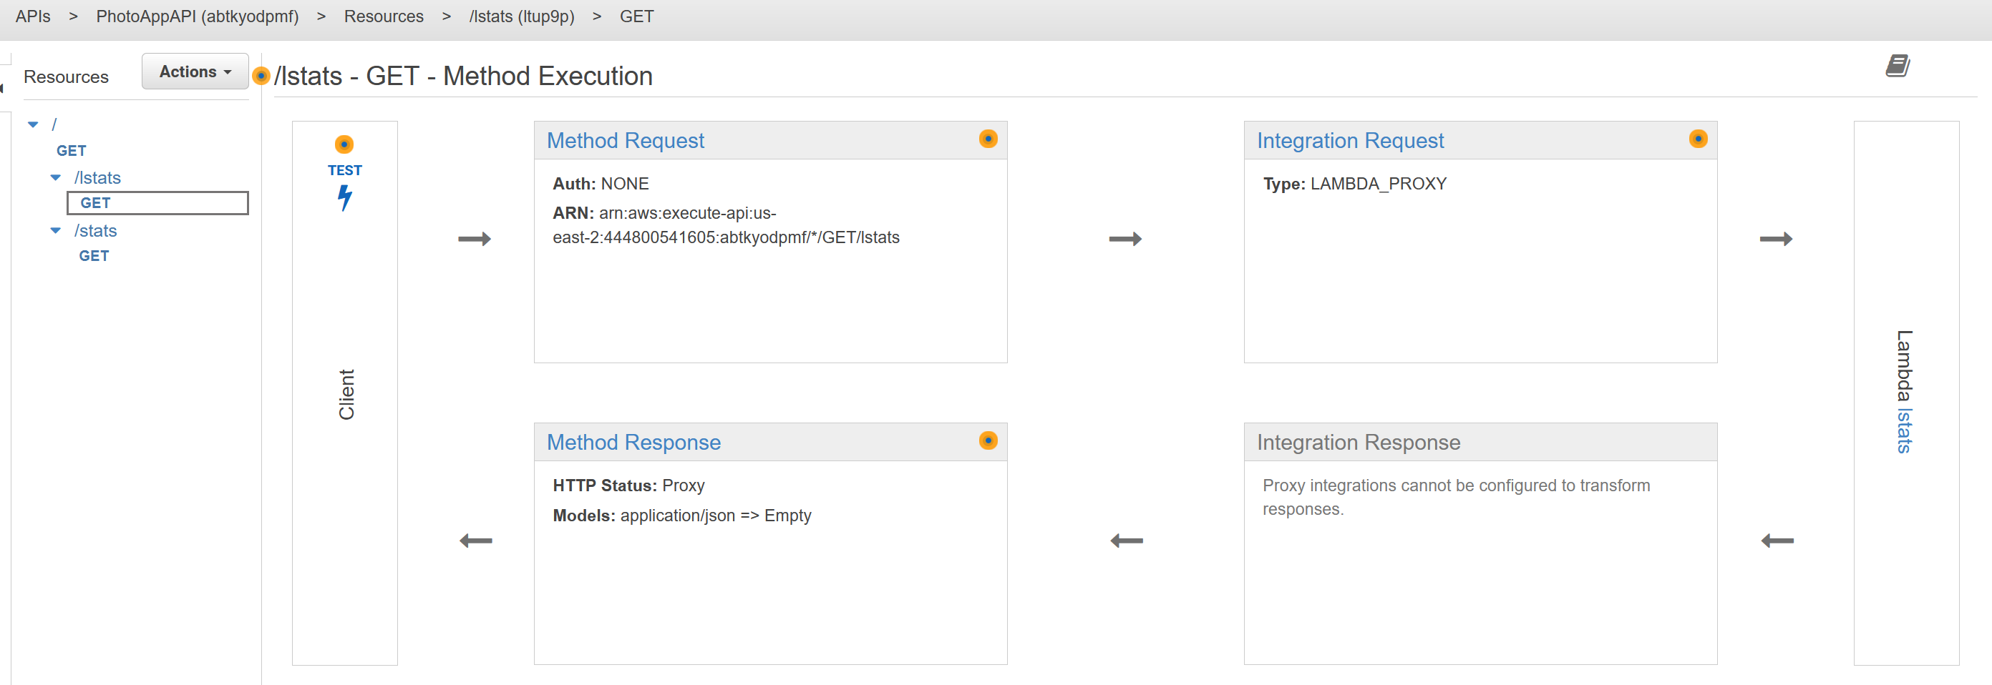
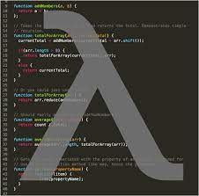





API Gateway
API Gateway allows you to define a RESTful API that forwards to other services / lambdas
Define HTTP verb and URL path (e.g. GET /movies)
Specify target…

Slide 3
Programming demo
Let's build a simple calculator using API Gateway and lambda…

Slide 4









In-class programming demo
Let's build a simple calculator using API Gateway and lambda…

Slide 5
#
# uuid()
#
import json
import uuid
def lambda_handler(event, context):
result = str(uuid.uuid4())
print("uuid:", result)
return {
'statusCode': 200,
'body': json.dumps(result)
}
(1) lambda functions
#
# factors(n)
#
import json
def lambda_handler(event, context):
params = event["queryStringParameters"]
n = int(params["n"])
i = 2
factors = []
while i * i <= n:
if n % i:
i += 1
else:
n //= i
factors.append(i)
if n > 1:
factors.append(n)
print("factors:", n, factors)
return {
'statusCode': 200,
'body': json.dumps(factors)
}
#
# pow(x, e)
#
import json
def lambda_handler(event, context):
params = event["pathParameters"]
x = float(params["x"])
e = float(params["e"])
result = x ** e
print("pow:", x, e, result)
return {
'statusCode': 200,
'body': json.dumps(result)
}
Notes:
Don't forget to increase timeout on factors to at least 1 minute…

Slide 6
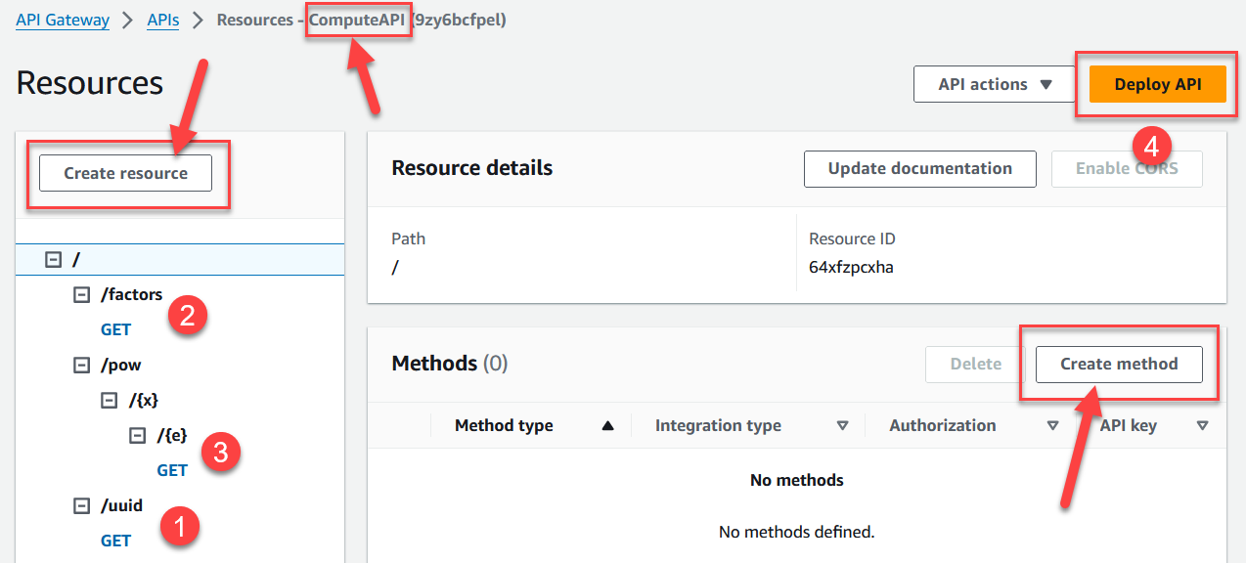
(2) Build API
In AWS, search for API Gateway service
Create API
Select: REST API
Name: ComputeAPI
Create resources and method as shown (steps 1-3)
When you create methods:
Lambda function
Enable Lambda proxy integration
Select function
When you're done, click "Deploy" and stage if you want (e.g. test)
Notes:
Any errors, delete and re-check the proxy integration

Slide 7
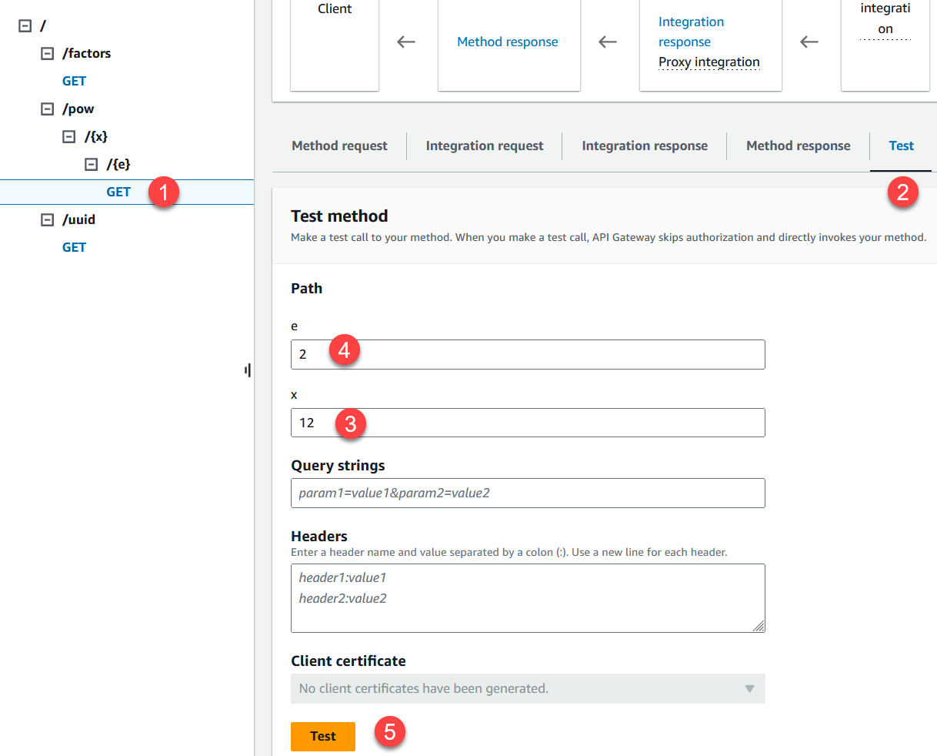
(3) Test API
Use the Test tab to test each function…
uuid( ) has no parameters
factors(n) has a query parameter, e.g. ?n=33
pow(x, e) has path parameters, e.g. /pow/12/2

Slide 8
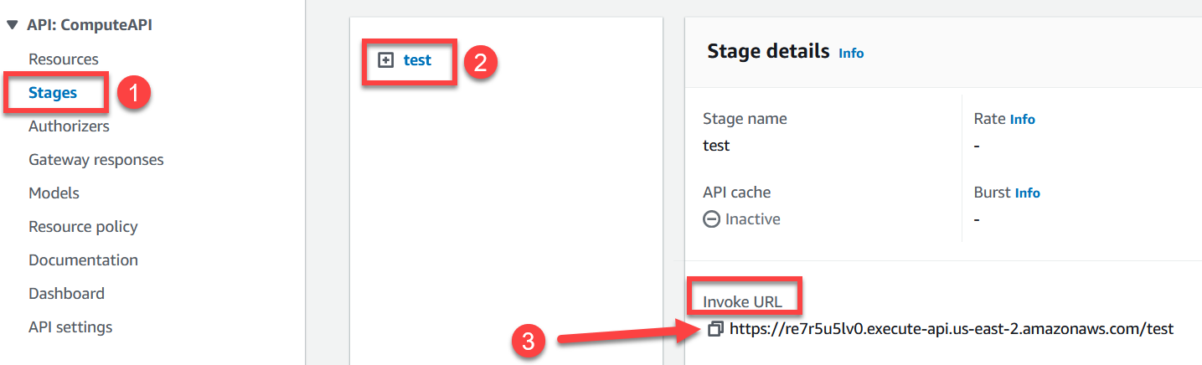
(4) Deploy and copy API endpoint
Click "Deploy API"
Stages --- none, or e.g. "test" or "prod" (production)
Click "Deploy"
View stage, copy "Invoke URL"

Slide 9
(5) client-side testing
Since all the methods are GET, use web browser
API Gateway Endpoint/uuid
API Gateway Endpoint/factors?n=33
API Gateway Endpoint/pow/2/16
Alternatively:
postman.com
HTTP requests from client app

Slide 10
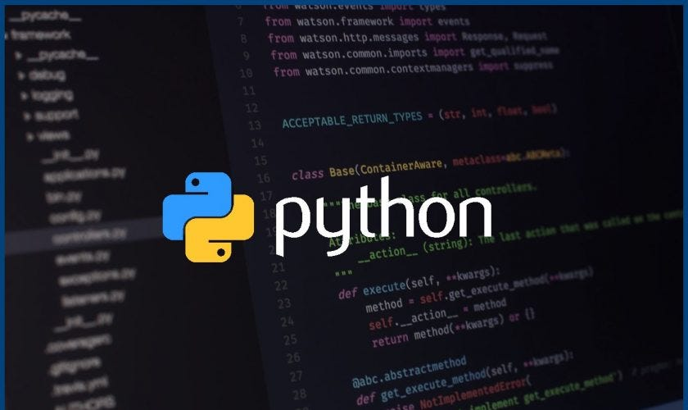
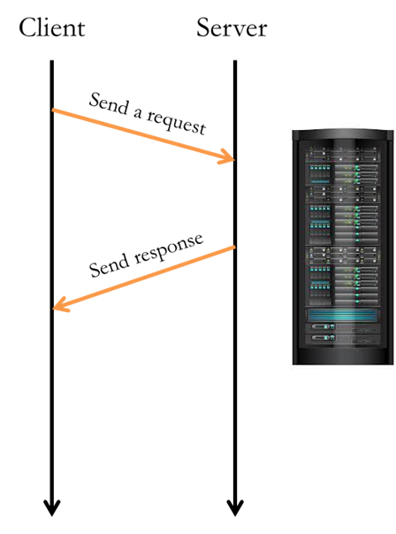
Python-based client-side app
import requests
baseurl = 'API Gateway Endpoint'
x = input('Enter base x> ')
e = input('Enter exponent e> ')
# build URL:
url = baseurl + '/pow/' + x + '/' + e
# call the web service:
response = requests.get(url)
# output the result:
body = response.json()
print('status code:', response.status_code)
print('result x^e:', body)

Slide 11
Summary
We have a serverless solution to running computations in the cloud

Slide 12
Recall what we did earlier…
We did a similar web service using JS and node.js
const express = require('express');
const app = express();
// main():
app.listen(3000, () => {
console.log('**SERVER: web service running, listening on port 3000...');
});
// requests for default page /:
app.get('/', (req, res) => {
console.log('**SERVER: call to /');
res.send('<HTML><body>Home page is empty, we are a calculator service!</body></HTML>');
});
// API functions:
// raise x to the exponent e:
app.get('/pow/:x/:e', (req, res) => {…});
.
.
.

Slide 13

AWS lambda
By far the simplest, least expensive way to compute
EC2, EKS, ECS, Fargate
Elastic Beanstalk
API Gateway + Lambda
Lambda
function
Notes:
Azure functions (Microsoft), Cloud functions (Google)

Slide 14
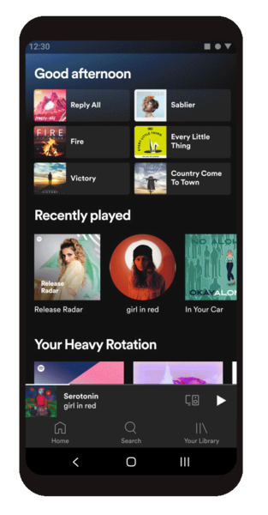

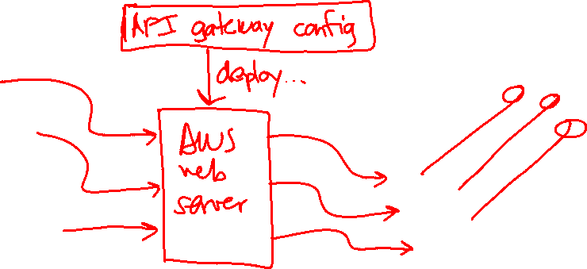

Calling lambda functions
We used API Gateway to "call" our lambda functions
All the benefits of a traditional multi-tier design
Offers the most customization / config options

Slide 15
(1) Calling lambda via function URL
Multi-tier through AWS-managed web server
url = 'https://.../?n1=10&n2=20'
response = requests.get(url)
Multi-tier design with the usual advantages. Good for simpler apps with a small API (not too many URLs)
Cannot map to non-lambda services to improve latency; limited configuration options (e.g. cannot support real-time WebSocket apps)

Slide 16
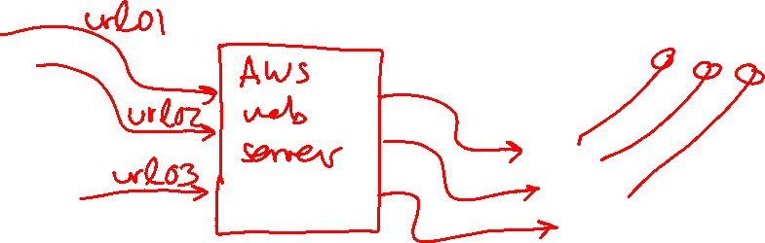
(1) Calling lambda via function URL
Multi-tier through AWS-managed web server
url = 'https://.../?n1=10&n2=20'
response = requests.get(url)
Multi-tier design with the usual advantages. Good for simpler apps with a small API (not too many URLs)
Cannot map to non-lambda services to improve latency; limited configuration options (e.g. cannot support real-time WebSocket apps)

Slide 17
(2) Calling lambda directly from client
You can use AWS libraries (e.g. boto3) to call lambda functions directly…
result = lambda.invoke(
FunctionName="factors",
Payload=json.dumps({"n": 33})
)
Great for small projects and prototypes…
Requires config / credentials on the client; standard installation concerns; less secure?

Slide 18

(2) Calling lambda directly from client
You can use AWS libraries (e.g. boto3) to call lambda functions directly…
result = lambda.invoke(
FunctionName="factors",
Payload=json.dumps({"n": 33})
)
Great for small projects and prototypes…
Requires config / credentials on the client; standard installation concerns; less secure?

Slide 19
That's it, thank you!

